Slide 1
11talk FAQ Student page TW

Slide 2
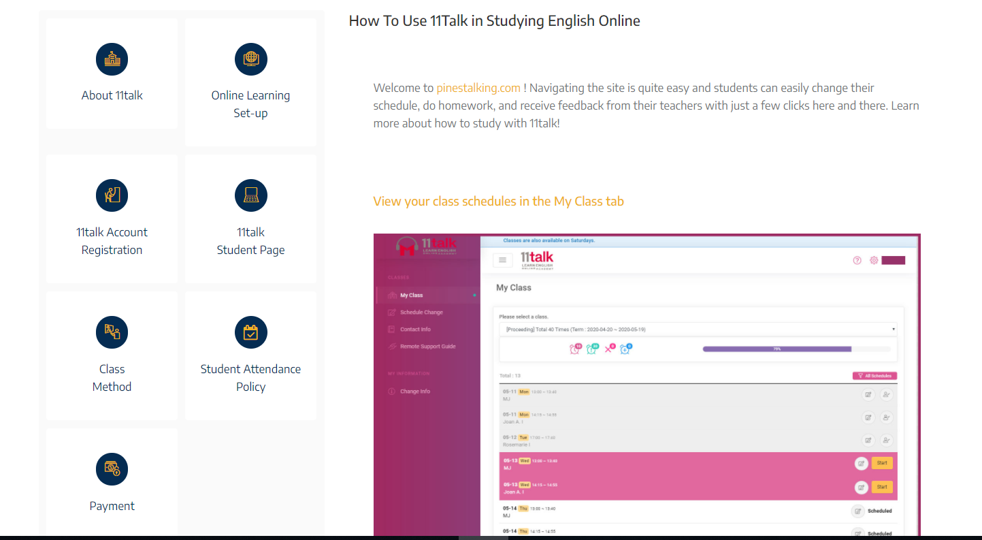
如何使用使用11Talk的線上英語
歡迎來到pinestalking.com！ 網站的操作非常容易，學生只需在這里點幾下，就可以輕鬆地更改時間表，做功課並從老師那裡收到建議。進一步了解如何使用11talk學習！
在我的課程頁中查看您的時間表
11TALK
學生畫面

Slide 3
You can easily change your class schedule in the Schedule Change tab.
您可以在“更改時間”選項中輕鬆更改班級時間表。
Delete the schedule you want to change by clicking the pink ‘x’ icon.
點擊紅色的“ x”圖案，刪除要更改的時間表。

Slide 4
The previous schedule has now been deleted and you can now add a new one. Click on the blue ‘+’ icon.
以前的時間表已刪除，您現在可以增加一個新課程時間。點擊藍色的“ +”圖標。
Add the date on your preferred schedule and time. You can add a Saturday class if you have no time for classes during the weekdays.
在您喜歡的時間中增加日期。如果您在工作日沒有時間上課，則可以增加星期六課程。
After choosing a date and time, search for a teacher and select an available slot.
選擇日期和時間後，搜尋老師並選擇一個可用的時段。
After selecting a teacher, confirm your new schedule by clicking OK.
選擇老師後，點下“確定”確認新的時間表。
Your schedule has now been changed and added.
您的日程安排現已更改並增加。
Students can also receive and turn in homework through the site. Click on the pen icon to view your homework. The green number icon indicates how many homework tasks have been completed.
學生還可以通過該網站接收並上交作業。點下筆圖標以查看您的作業。綠色數字表示已完成多少作業。
Students are able to do daily homework and receive free writing correction as well.
學生可以進行日常作業，還可以免費寫作更正。

